Slide 1

TOPIC: AIR POLUTION ANALYSIS

Slide 2
INTRODUCTION
Air pollution occurs when harmful substances including particulates and biological molecules are introduced into Earth’s atmosphere.
It may cause diseases, allergies or death of humans
it may also cause harm to other living organisms

Slide 3
objective
To compile, interpretate the data with various statistical methods and to develop reliable and qualitative data
To develop a track record and to provide the data to monitoring authorities for making management strategies, regulations, policies to mitigate air pollution.

Slide 4
TYPES OF POLUTANTS
PRIMARY POLLUTANTS –
Primary pollutants are usually produced from a process, such as ash from a volcanic eruption. Other examples include carbon monoxide gas from motor vehicle exhaust
E.g: NO (nitrogen monoxide),NO2 (nitrogen dioxide),
SO2 (sulfer dioxide),PM10 (particulate matter)
SECONDARY POLLUTANTS - Secondary pollutants are not emitted directly. Rather, they form in the air when primary pollutants react or interact.
E.g:O3 (ground level ozone)

Slide 5
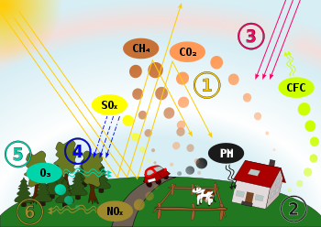
CYCLE OF POLLUTANTS

Slide 6
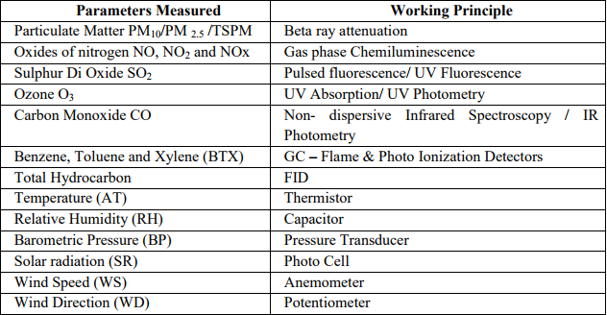
ANALYZERS AND ITS WORKING PRINCIPALS

Slide 7
Time series analysis
DIURNAL VARIATION OF POLLUTANTS:
Analysis in Summer Season:
Duration – (01-Feb-2011 to 22-Mar-2011)

Slide 8
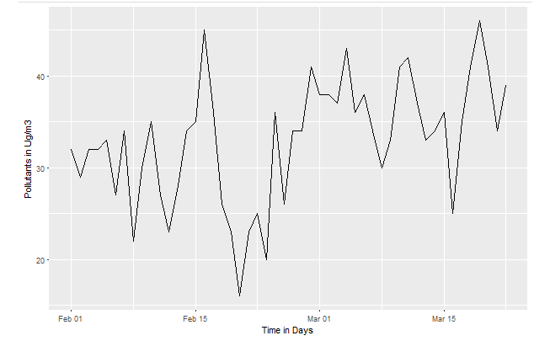
Diurnal Variation of O3 Layout

Slide 9
The average diurnal concentration of O3 ranges between 16 μg/m3 to 46 μg/m3 with mean value 32.98 μg/m3 .
The time series graph of O3 concentration in summer season shows that the concentration rises during 14-Feb To 16-Feb and 17-March To 19-March.
On 18-Feb O3 concentrations is maximum.
On 20-Feb O3 concentration is minimum.

Slide 10
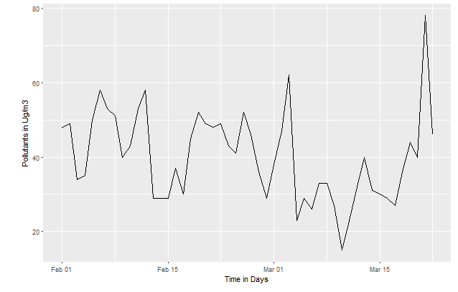
Diurnal Variation of NO2 Layout

Slide 11
The average diurnal concentration of NO2 ranges between 15 μg/m3 to 78 μg/m3 with mean value 40.01 μg/m3 .
The time series graph of NO2 concentration in summer season shows that the concentration rises during 1-March To
3-March and,During 20 And 21 March .
On 21-March NO2 concentrations is maximum.
On 10-March NO2 concentration is minimum.

Slide 12
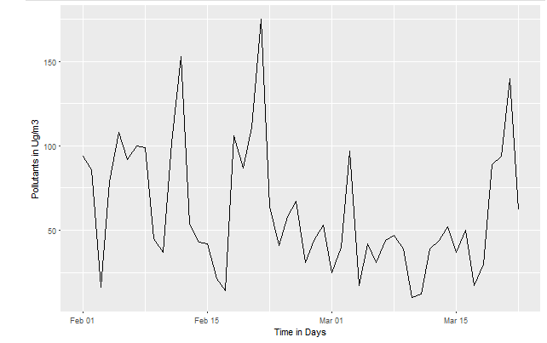
Diurnal Variation of NO Layout

Slide 13
The average diurnal concentration of NO ranges between 10 μg/m3 to 175 μg/m3 with mean value 61.06 μg/m3 .
The time series graph of NO concentration in summer season shows that the concentration rises during 10,11,20,21 Feb, And 21 March .
On 21-Feb NO concentrations is maximum.
On 10-March NO concentration is minimum.

Slide 14
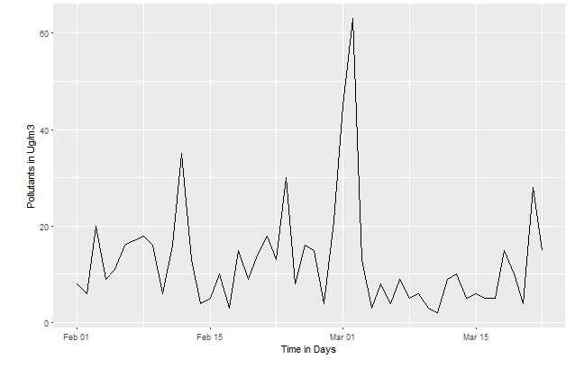
Diurnal Variation of SO2 Layout

Slide 15
The average diurnal concentration of SO2 ranges between 2 μg/m3 to 63 μg/m3 with mean value 12.98 μg/m3 .
The time series graph of SO2 concentration in summer season shows that the concentration rises during 28 Feb And 2-March .
On 2-March SO2 concentrations is maximum.
On 11-March SO2 concentration is minimum.

Slide 16
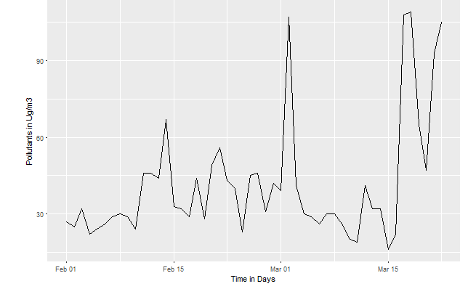
Diurnal Variation of PM10 Layout

Slide 17
The average diurnal concentration of PM10 ranges between 16 μg/m3 to 109 μg/m3 with mean value 41.58 μg/m3 .
The time series graph of PM10 concentration in summer season shows that the concentration rises during 2,16,17, March And 22 March .
On 18-March PM10 concentrations is maximum.
On 15-March PM10 concentration is minimum.

Slide 18
Analysis in winter season
Duration – (01-Nov-2011 to 20-Dec-2011)

Slide 19
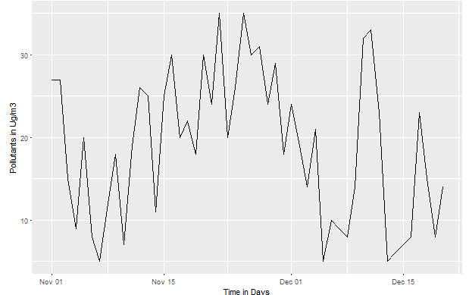
Diurnal Variation of O3 Layout

Slide 20
The average diurnal concentration of O3 ranges between 5 μg/m3 to 35 μg/m3 with mean value 18.88 μg/m3 .
The time series graph of O3 concentration in winter season shows that the concentration is constantly fluctuating.
On 22-Nov O3 concentrations is maximum.
On 13-Dec O3 concentration is minimum.

Slide 21
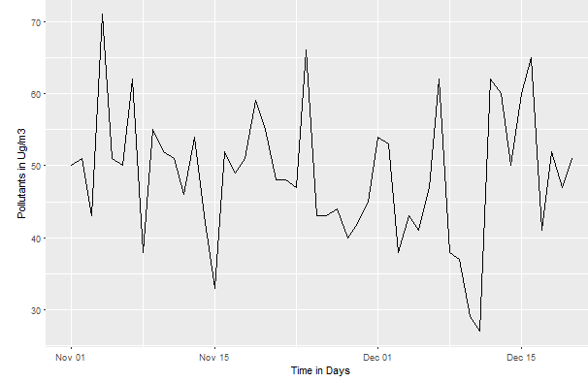
Diurnal Variation of NO2 Layout

Slide 22
The average diurnal concentration of NO2 ranges between 27 μg/m3 to 71 μg/m3 with mean value 48.78 μg/m3 .
The time series graph of NO2 concentration in winter season shows that the concentration rises during 4-Nov,7-Nov And 24-Dec .
On 4-Nov NO2 concentrations is maximum.
On 11-Dec NO2 concentration is minimum.

Slide 23
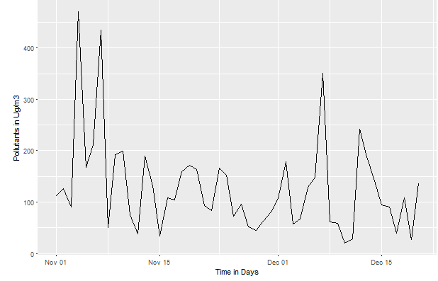
Diurnal Variation of NO Layout

Slide 24
The average diurnal concentration of NO ranges between 20 μg/m3 to 470 μg/m3 with mean value 128.12 μg/m3 .
The time series graph of NO concentration in winter season shows that the concentration rises during 4-Nov,7-Nov And 4-Dec .
On 4-Nov NO concentrations is maximum.
On 10-Dec NO concentration is minimum

Slide 25
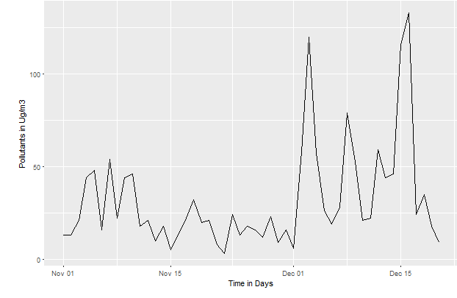
Diurnal Variation of so2 Layout

Slide 26
The average diurnal concentration of SO2 ranges between 3 μg/m3 to 133 μg/m3 with mean value 32.34 μg/m3 .
The time series graph of SO2 concentration in winter season shows that the concentration rises during 3,15 And 16-Dec .
On 16-Dec SO2 concentrations is maximum.
On 22-Nov SO2 concentration is minimum.

Slide 27
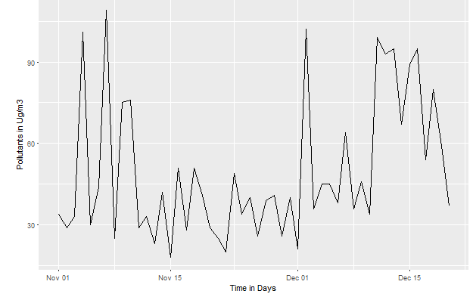
Diurnal Variation of pm10 Layout

Slide 28
The average diurnal concentration of PM10 ranges between 18 μg/m3 to 109 μg/m3 with mean value 49.52 μg/m3 .
The time series graph of PM10 concentration in summer season shows that the concentration is continiously fluctuating.
On 07-Nov PM10 concentrations is maximum.
On 15-Nov PM10 concentration is minimum.

Slide 29
COrRELATION ANALYSIS
The results of season wise correlation between pollutants during summer (February And March) and winter (November And December) seasons using the Daily data from 2011 are provided in the table

Slide 30
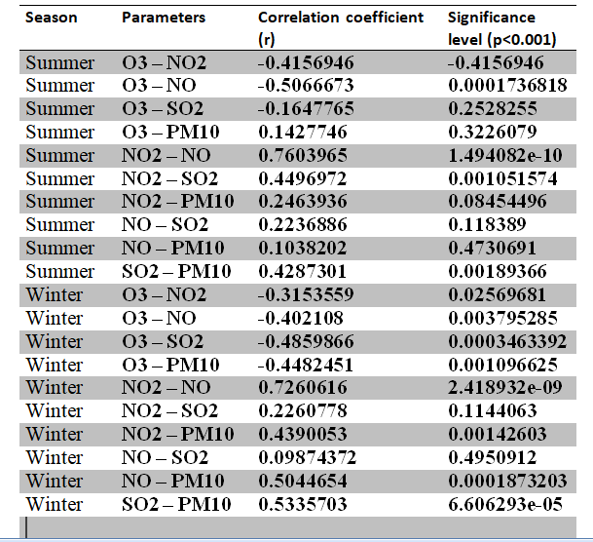

Slide 31
There is weak correlation between pollutants such as O3 with NO, NO2, SO2 during both the season .
During summer, NO and NO2 has strong positive correlation of 75% ; O3 and NO2 has negative moderate correlation of 58% .
The positive correlation indicates increase in corresponding concentration of one pollutant with increase in concentration of other pollutant, while negative correlation indicates corresponding decrease in concentration of one pollutant with increase in concentration of the other pollutant.
During winter, NO and NO2 has moderate positive correlation of 70% . PM10 with NO and SO2 have moderate positive correlation of 60% .

Slide 32
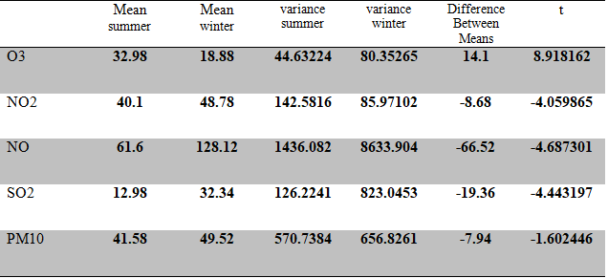
T test analysis

